Slide 1
CUSTOM RAG SYSTEM
Project Manager: Nguyễn Trường Sơn
Mentor: Trương Minh Hiệp
Intern: Trần Quang An Quốc

Slide 2
1. Revision History
Revision number | Date | Content
1.0 | September 30, 2024 | Explore RAG concepts, research Continue extension
2.0 | October 3, 2024 | Explore Custom RAG system
3.0 | October 7, 2024 | Utilize Gemini for embedding task and integrate into Continue extension
4.0 | October 15, 2024 | Explore automatically re-indexing
5.0 | October 21, 2024 | Add Docker deployment instructions

Slide 3
2. Architecture Overview
Google Generative AI API: Integrates AI-powered text embedding capabilities for content analysis.
LanceDB: A vector database used for storing and querying embedded code chunks.
Tornado Web Framework: Provides the web server infrastructure to handle HTTP requests and responses asynchronously.
PyJWT: Used for generating and decoding JSON Web Tokens (JWTs) to authenticate and authorize users.
ThreadPoolExecutor: Used for executing CPU-bound tasks asynchronously and concurrently.

Slide 4
3. Flow of Operation
3.1 Authentication
3.2 Indexing
3.3 Retrieving
3.4 Re-indexing

Slide 5
3.1 Authentication
AuthenHandler: Client authenticate using a unique token generated by the /auth endpoint.
JWT tokens are used to authenticate subsequent requests to protected endpoints (/index, /retrieve, /reindex).

Slide 6
3.2 Indexing
IndexHandler: Accepts a GET request to /index with folder path parameter.
Retrieves all code files (*.py) within specified folder.
Embeds chunks of code using Google Embedding and stores them in LanceDB.

Slide 7
3.3 Retrieving
RetrieveHandler: Accepts a POST request to /retrieve.
Receives a query or input from the client, processes it, and search for similar code chunks in LanceDB.
Returns context items containing code file names, descriptions, and content based on search results.

Slide 8
3.4 Reindexing
ReindexHandler: Accepts a POST request to /reindex with folder paths parameter.
Deletes existing embedding associated with specified folders.
Indexes all code files within the specified folders again, updating LanceDB with new embedding.

Slide 9
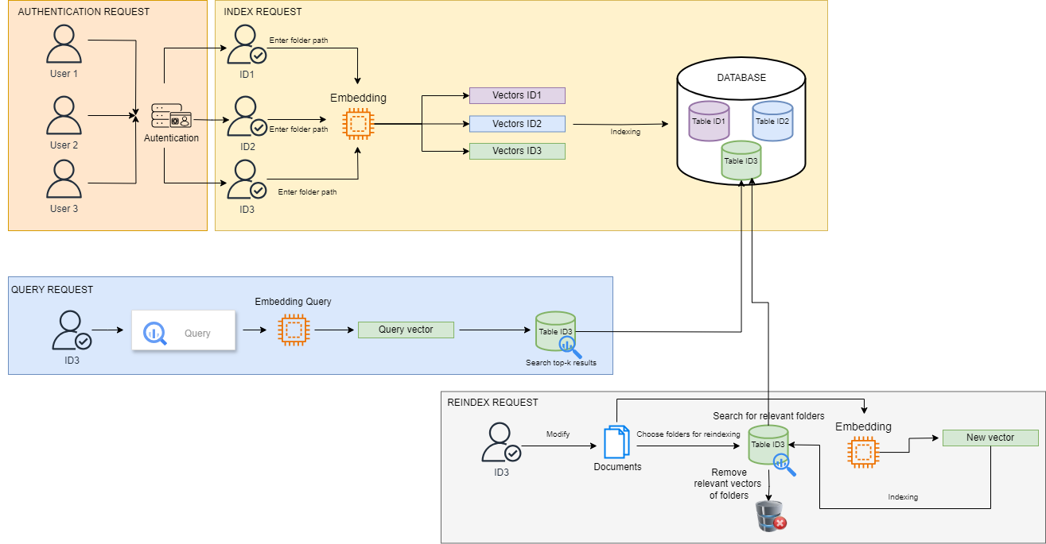
3.5 Workflow

Slide 10
4. Related packages
Packages | Function
LanceDB | Vector Database
Pyarrow | Schema Definition
Tornado | Request Handler
PyJWT | Authentication
Google-generativeai | Embedding
Asyncio | Asynchronous programming
numpy | Mathematic
pandas | Dataframe

Slide 11
5. Run via Docker
1. Ensure you have Docker installed on your system.
2. Build the Docker image:
docker build -t rag-system .
3. Run the Docker container:
docker run -p 8000:8000 rag-system
3. Access the application by using Postman to send request to http://localhost:8000

Slide 12
6. Reference
Google Generative AI API Documentation: Google API Docs
LanceDB Documentation: LanceDB Docs
Continue Documentation: Continue Docs
Tornado Documentation: Tornado Docs
PyJWT Documentation: PyJWT Docs
Docker Documentation: Docker Docs

